Slide 1

Azure AZ-305 Capstone
Scenario Sample Answer

Slide 2
Overall Design Assumptions
Transit Hub already exist
Attempting to meet dedicated host requirements and isolation.
Cost will be shown but no cost limitations were described in the scenario.
Three-year reservations will be shown as an option. Some companies have fiscal law and contracting restrictions which prohibit three year reservations.
All Private IPs fall within Customer-registered RFC 1918 space.

Slide 3
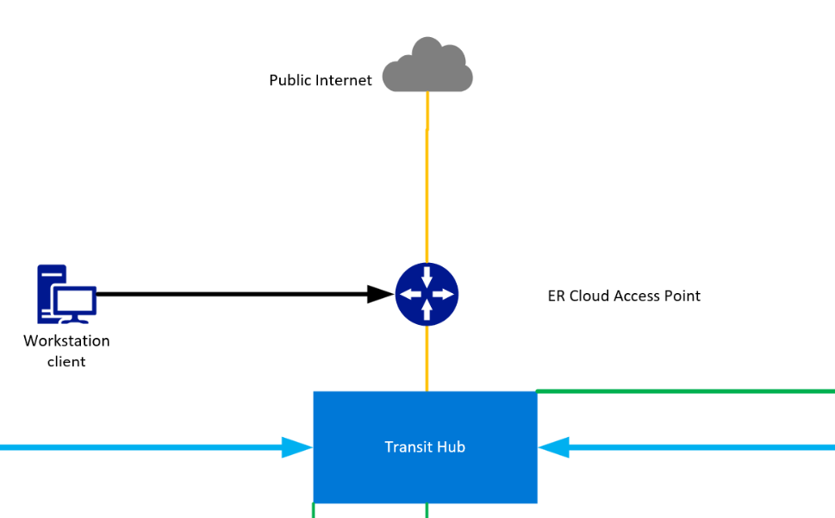
Ingress to Subscription & Transit Hub
Traffic flow from Public internet is via Transit Hub Firewall.
CSP Provider anchors the Azure ExpressRoute to the transit hub subscription.
Transit Hub and security stack are assumed to exist and have all required services in place.
AzureAD, ADFS, and all identity services are assumed to be provided by Customer.
Azure Bastion or similar Jump box/Bastion service resides in MO subscriptions.

Slide 4
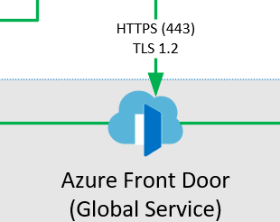
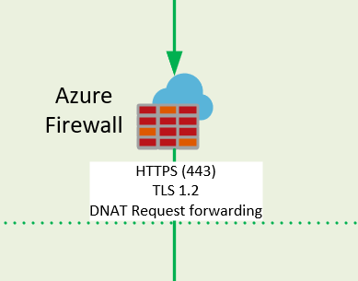
Web Application – Azure Front Door and Azure Firewall
Azure Front Door will be the entry point to the Web Application Front End. This service offers geographic load balancing, web app firewall, and DDoS protections.
Azure Front Door will route traffic to the regional Azure Firewall public interface.
Azure Firewall will be configured to destination NAT (DNAT) the web traffic to the Azure Load Balancer (Internal) which balances traffic to the Virtual Machine Scale Sets sitting in the Availability Zones in each region.
*Note* -Some Customer regions may not currently support Availability Zones. This design could be modified to drop AZ's and use Availability sets until AZ’s become available.
An Azure Private Link will be used on the forward facing Azure Load Balancer if the Azure Firewall configuration will support it.

Slide 5
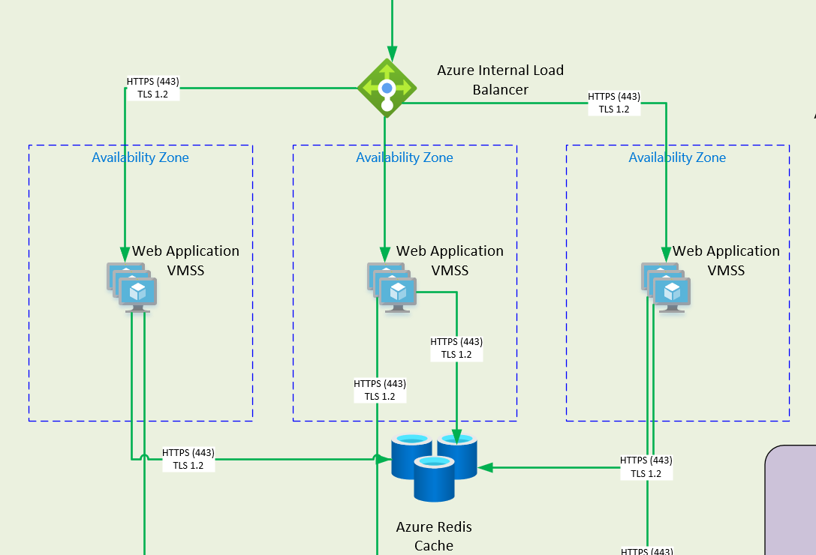
Web Application – Web App
Web Servers will run inside Virtual Machine Scale Sets (VMSS) utilizing Standard_D8s_v3 sku and Customer STIG’d images. This limits the VMSS to no more than 600 nodes per VMSS.
Each VMSS will be autoscaling enabled with request metrics for scale up and down.
At max peak work load (Monday from 0900-1200), the VMSS will be expanded to at least 800 nodes. Ideally this would be 400 nodes per region and 134 nodes in each Availability Zone VMSS.
At all other times the peak would be 40 nodes (20/Region,7/AZ).
At Non-peak time normal business hours there would be minimum of 8 VMSS nodes (4/Region,1/AZ)
Outside normal business hours there will be 4 VMSS nodes, 2 in each region to handle all request.
Recommend that 4 of the VMSS nodes will be reserved instance for cost control.

Slide 6
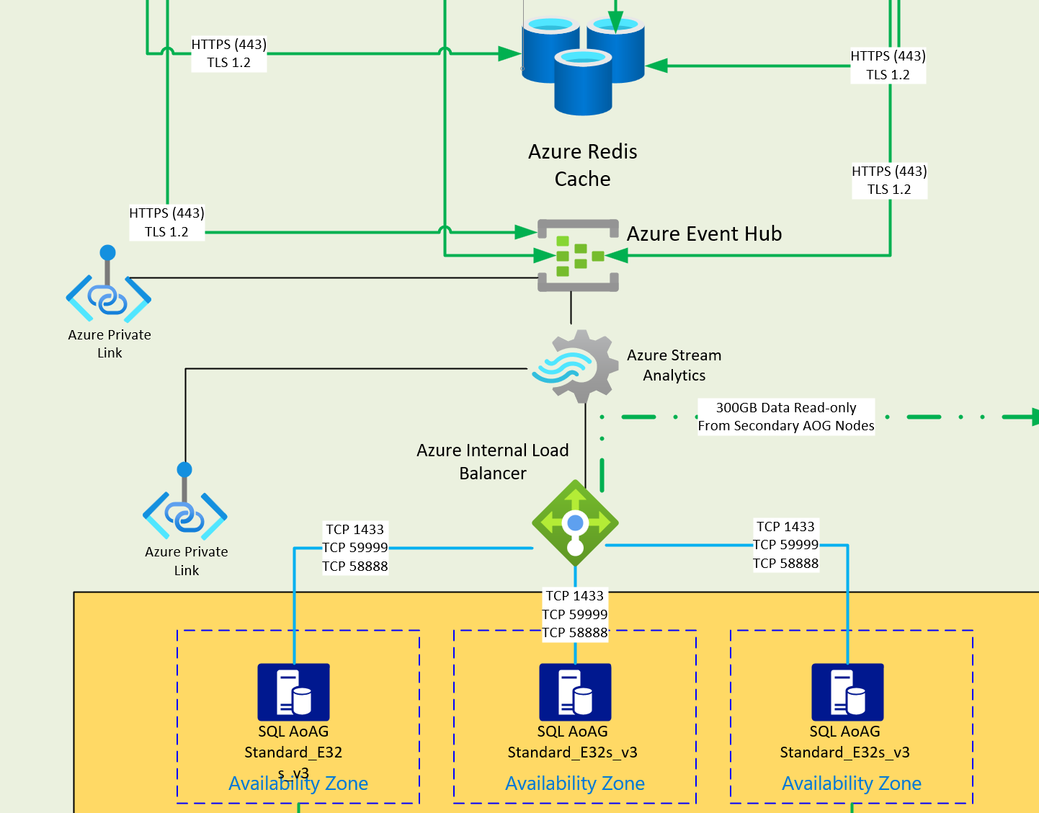
Application Activity
Application activity will be streamed to Azure Event Hub for message queueing with a private endpoint to remove public access.
Azure Stream Analytics will be used to ingest the events from the web front end Event Hub and moved to the SQL database.
A dedicated Event Hub instance will be provisioned to meet dedicated host requirements. Also offers better performance and cost at high work loads.
Short term session caching will be held in Azure Cache for Redis P1 premium tier with six gigabytes of cache. Premium provides enhanced security and network isolation.

Slide 7
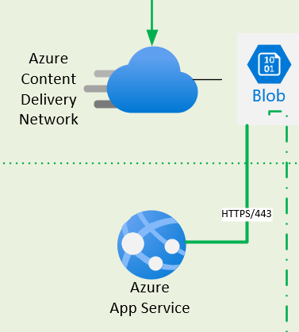
Static/User Files
File content will be delivered via Azure Content Delivery Network in a single region.
File storage region will paired with the Analysis servers to provide lower latency for Analysis server ingestion reads.
A Web frontend will be deployed on dedicated Web App Service which will provide a web interface for the file storage.
The web app will provide role based access control to files for external retrieval utilizing SAS tokens and SAML tokens.

Slide 8
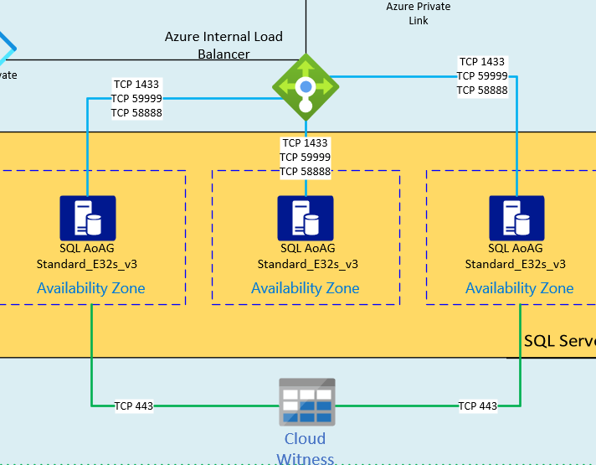
Database cluster
The Database cluster will be hosted on six Standard_E32s_v3 dedicated host VMs configured in an AlwaysOn Availability Group with three nodes in each region.
The database IaaS servers will be configured to replicate between regions asynchronously.
The database AlwaysOn secondary region nodes will be used for Analysis server reads to prevent congestion on the primary region database servers.
The design will offer disaster recovery protection as the SQL IaaS can be failed over to use the alternate region as primary in a complete region outage.

Slide 9
Backups
All servers will be backed up utilizing Azure Backup on daily and weekly basis if there are data recovery requirements.
Backup and Disaster recovery requirements will be driven by the Business Impact Analysis and recovery service levels defined by the customer.
Database backups will be daily for seven days, weekly for one month, and monthly backups stored in long-term archive storage.

Slide 10
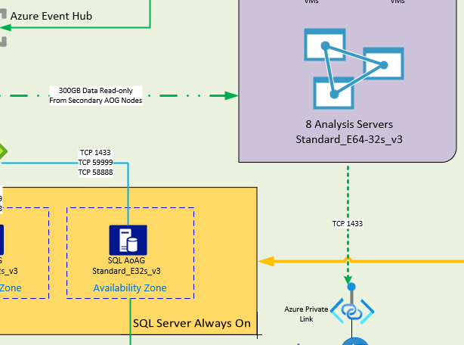
Analysis Services
Four nightly analysis jobs will be run nightly on eight E64-32s_v3 dedicated host in the secondary region.
Running in the secondary region will offload the pull of data from primary region SQL servers.
In the case of region failover, one of the three nodes in the secondary region could be marked ‘passive’ and used for analysis.
Analysis results will be written to DBaaS SQL instance daily before shutdown.
The analysis servers will be started daily by an Azure Automation runbook. A second runbook will stop the nodes once the analysis job is confirmed to be completed. This could be accomplished via a webhook call from the analysis application.

Slide 11
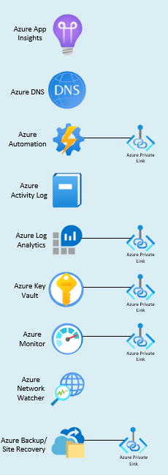
Additional Azure Services
Azure DNS will be used to support DNS request and Private Link address resolution.
Azure Activity Log will be used to meet requirements for fabric level change logging.
Azure Monitor/Log Analytics will be used for IaaS change tracking, logging aggregation, and data action logging.
Azure Monitor will be leveraged to watch performance and Azure Alerts will be configured on key metric to notify of service impacts.
Azure Application Insights can be leveraged for custom web application monitoring and end user performance.
Azure Key Vault Premium will be used to meet FIPS 140-2 requirements. It will securely hold secrets, certificates, and keys.
Azure Policy will be used to prevent public IP addresses from being created on infrastructure as a service VMs. Other NIST SP800-53 policies will be enforced based on the ATO security requirements traceability matrix.

Slide 12
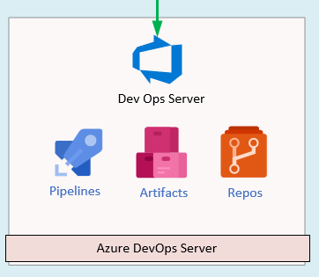
Development Operations (DevOps)
Azure DevOps (ADO) Server will be deployed to handle Continuous Integration/Continuous Delivery (CI/CD).
Azure Repos will contain all code for server IaaS, PaaS, and Web code deployments. It will also be used for Documentation as Code (DaC) repositories.
ADO Pipelines will be used for secure deployment of code to Azure fabric utilizing AzureAD App Registrations.
Azure Artifacts will be used to house any required external packages or artifacts for internal deployment.
Another option, if Azure DevOps is not desirable, is to utilize the current Customer DevSecOps platform.

Slide 13
Azure Solution Costs Assumptions
All costs are based on EastUS and WestUS.
Organization should have sufficient licenses for Azure Hybrid Use Benefits (AHUB). All Windows nodes will be enabled with AHUB.
Customer should have SQL licenses to enable the use of SQL Hybrid Use Benefits.
All costs will be recommended with one year reserved instances but I will show PAYG and 3-year RI’s for comparison. If 3-Year RI's are allowed per contracting regulations for Customer, then my recommendation is that the customer utilize the longer term RI’s to save cost.

Slide 14
One Year vs. Three Year Reserved Instances
One Year RIs | Estimated monthly cost | Estimated upfront cost
Total | $30,732.07 | $105,827.46
Three Year RIs | Estimated monthly cost | Estimated upfront cost
Total | $30,732.07 | $206,257.00
Five Year Fiscal Outlook
FY Breakdown | FY21 | FY22 | FY23 | FY24 | FY25 | FY26 | Total 6 Year Cost
1YR Monthly x 12 | $368,784.85 | $368,784.85 | $368,784.85 | $368,784.85 | $368,784.85 | $368,784.85 | $2,212,709.10
1YR Upfront | $105,827.46 | $105,827.46 | $105,827.46 | $105,827.46 | $105,827.46 | $105,827.46 | $634,964.76
Total Annual Cost | $474,612.31 | $474,612.31 | $474,612.31 | $474,612.31 | $474,612.31 | $474,612.31 | $2,847,673.85
FY Breakdown | FY21 | FY22 | FY23 | FY24 | FY25 | FY26 | Total 6 Year Cost
3YR Monthly x 12 | $368,784.85 | $368,784.85 | $368,784.85 | $368,784.85 | $368,784.85 | $368,784.85 | $2,212,709.10
3YR Upfront | $206,257.00 |  |  | $206,257.00 |  |  | $412,514.01
Total Annual Cost | $575,041.85 | $368,784.85 | $368,784.85 | $575,041.85 | $368,784.85 | $368,784.85 | $2,625,223.11

Slide 15
No Reserved Instance Costing
One Year RIs | Estimated monthly cost | Estimated upfront cost
Total | $45,148.96 | $0.00
FY Breakdown | FY21 | FY22 | FY23 | FY24 | FY25 | FY26 | Total 6 Year Cost
No RI Monthly x 12 | $545,027.57 | $545,027.57 | $545,027.57 | $545,027.57 | $545,027.57 | $545,027.57 | $3,270,165.42

Slide 16

Questions?

